Slide 1
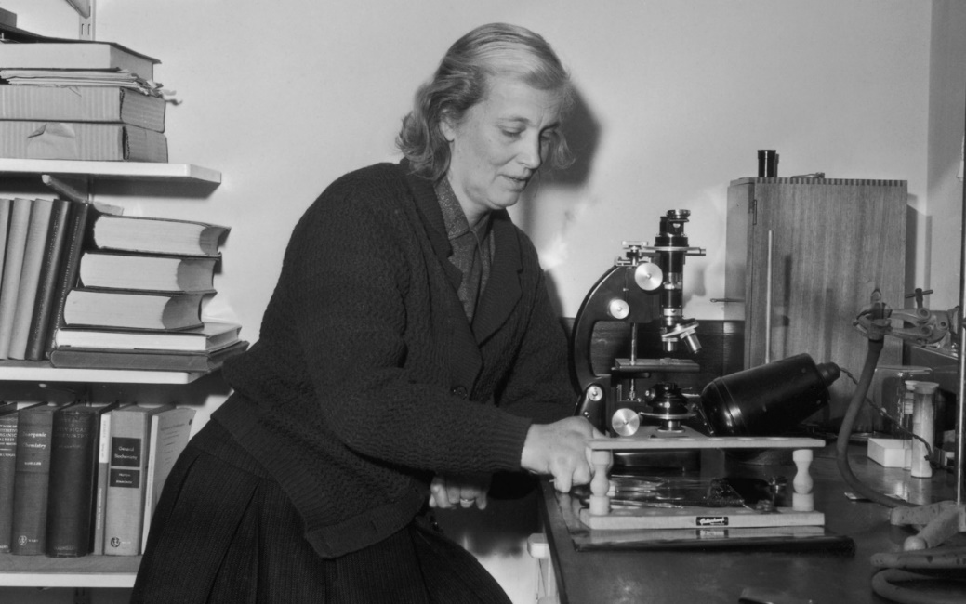
Dorothy Hodgkin
Making Molecules

Slide 2
What you should know before you start
Molecules
We see things when light travels from an object, or reflects off it, into our eyes. Molecules are made up of lots of atoms bonded together. Molecules that are found naturally in the body or in plants are called biomolecules.
Penicillin is an antibiotic made by moulds. It is used as a medicine to kill of harmful bacteria.
Insulin is a hormone in the body which regulates the amount of sugar in our blood. People with diabetes don’t make enough.
Vitamin B12 is essential for building blood cells and bone. We have to get it in our diet, and can’t make it in our bodies. Going without can make you ill.
X-rays
Molecules are too small to see with the our eyes, or even a microscope. But we can see them with x-rays so long as the molecules are set into a hard crystal. Biomolecules are notoriously difficult to make into crystals.
Slide 1

Slide 3
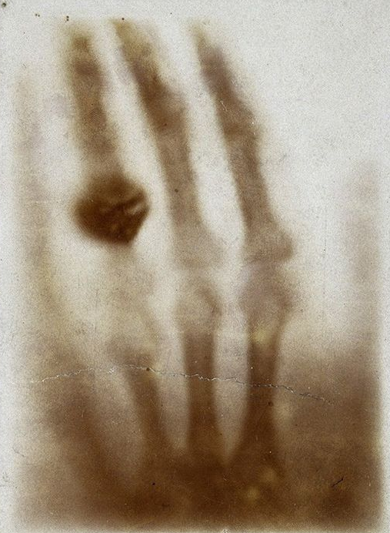
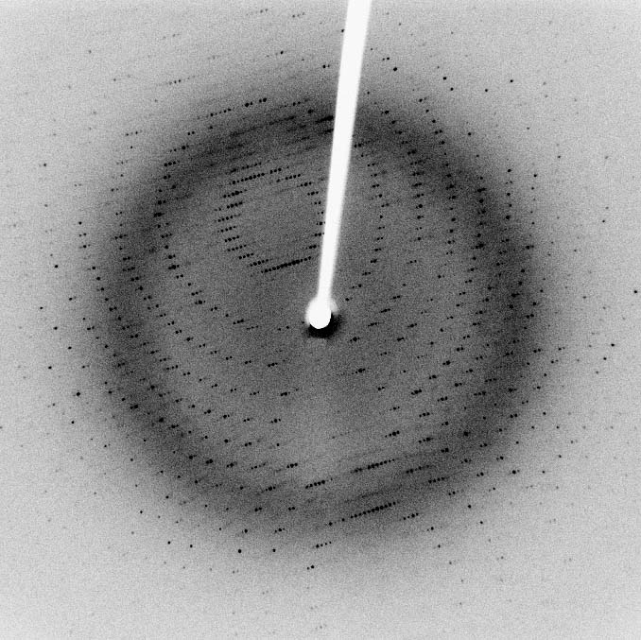
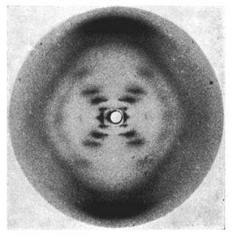
First medical X-ray
Protein scattering pattern
Photo 51
Slide 2
Notes:
Photo 51: https://en.wikipedia.org/wiki/File:Photo_51_x-ray_diffraction_image.jpg
First medical x-ray: https://commons.wikimedia.org/wiki/File:First_medical_X-ray_by_Wilhelm_R%C3%B6ntgen_of_his_wife_Anna_Bertha_Ludwig%27s_hand_-_18951222.jpg
Protein scattering pattern: https://en.wikipedia.org/wiki/X-ray_scattering_techniques#/media/File:X-ray_diffraction_pattern_3clpro.jpg

Slide 4
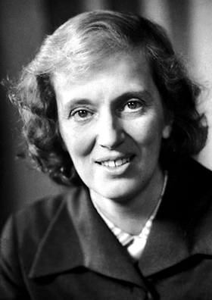
Dorothy Hodgkin
Slide 3
Notes:
https://en.wikipedia.org/wiki/File:Dorothy_Hodgkin_Nobel.jpg

Slide 5
Make a Cardboard Ball
1. To begin, read through all the instructions. Make a plan showing everybody’s role, and draw a picture of the planned product.
2. Using your protractor, ruler and pencil, draw a circle that is 10 cm in diameter on the cardboard. Carefully cut it out. This is your middle circle. You will need to make two of every other circle, gluing one above and one below your middle circle, like building a sandwich outwards from the filling.
3. First, you will need to make some decisions:
How many circles will you make?
If you make too many or too few circles, you might end up with a spheroid overall, not a sphere. Scientists call the number of circles used resolution. You might have to use trial and error to get your resolution right.
How big will your smallest circle be?
You could keep going infinitely, but this lesson is finite, so you will have to compromise. ~1 cm in diameter is a good small circle size.
Slide 4

Slide 6
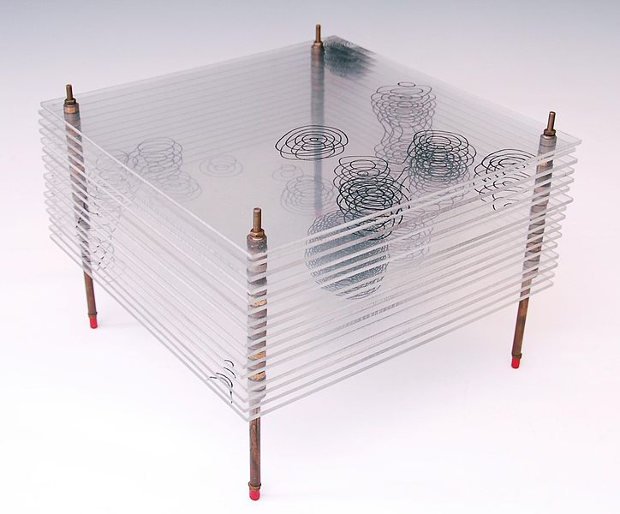
Dorothy Hodgkin’s Penicillin Model
Slide 5
Notes:
Dorothy Hodgkin’s penicillin model: https://en.wikipedia.org/wiki/File:Model_of_the_Structure_of_Penicillin,_by_Dorothy_Hodgkin,_Oxford,_c.1945.jpeg

Slide 7
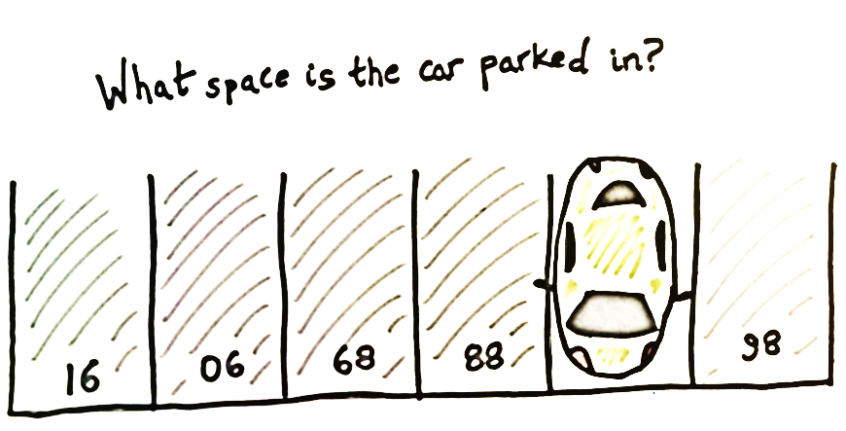
Slide 6

Slide 8
Photo Credits: All images – Wikipedia –public domain
© HMDT Music 2020

